Slide 1
http://awesome.krastyo.com/ http://github.com/San-Diego/PHP-Teamwork/

Slide 2

PHP BloG
PHP Teamwork, team SAN DIEGO
SoftUni, DECEMBER 2014

Slide 3
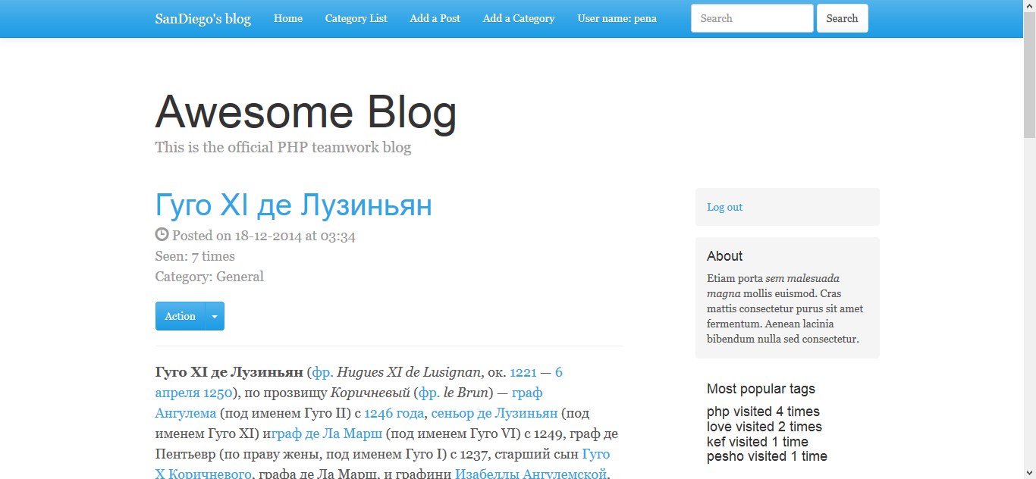
Project name and purpose
Name – “PHP BLOG”

Slide 4

Tools and resources
GitHub, PHP, HTML, CSS, Coggle, Bootstrap
Facebook, Skype

